Slide 1


BANK CUSTOMER ANALYSIS
AND CHURN PREDICTION
Data Bootcamp Final Project Presentation
DATA ANALYTICS PROJECT
BY MARIA TAYO

Slide 2


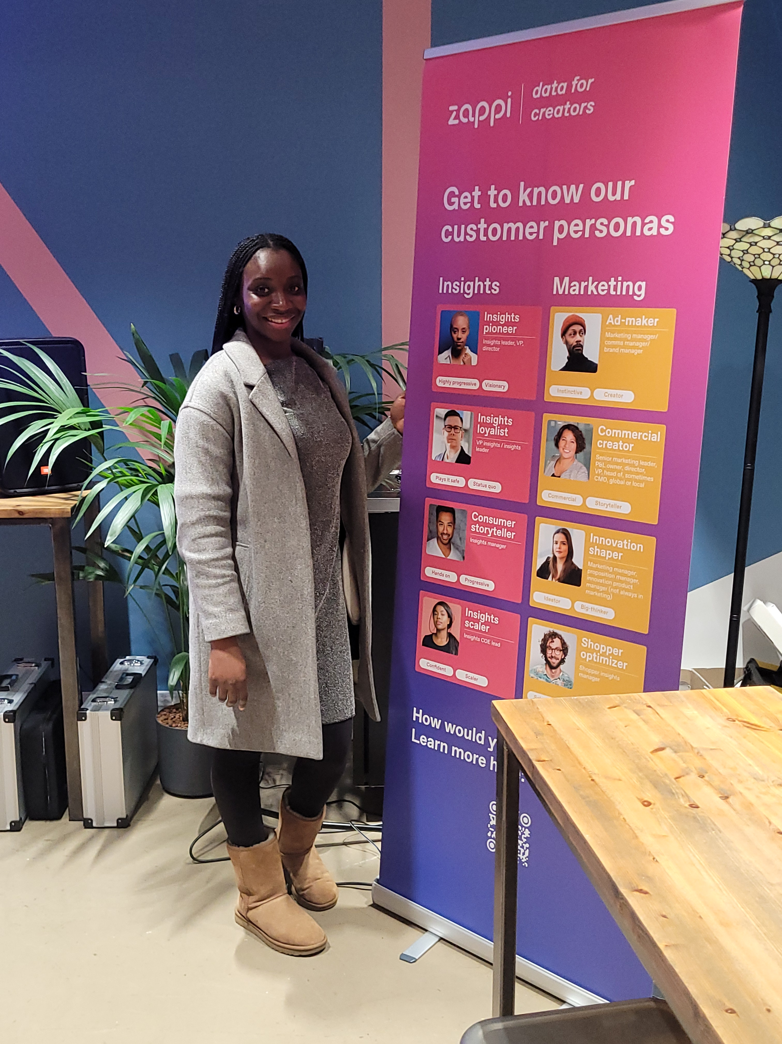
About Me and My Journey into Data & Tech
My name is Maria Tayo. After more than a decade in the legal industry I took a bold step of faith and stepped into the world of data. A Litigation Paralegal turned Data Analyst! On this journey of exploring and finding myself, I have also discovered my passion for Data and Business Intelligence and my curiosity when it comes to Technology.
Notes:
….I am excited about graduating from the Data Analytics boot camp.

Slide 3







Business Challenge & Objectives
CHALLENGE: A manager at the bank is disturbed with more and more customers leaving their credit card services. They would really appreciate it if I can predict for them who is going to get churned so they can proactively go to the customer to provide them with better services and turn customers’ decisions in the opposite direction.
Identify how many customers have churned i.e. left the credit card services.
Understand how customer churn differs across the different demographics.
Predict the customers that are likely to churn based on analysis, so that the bank manager can provide them with better services.

Slide 4

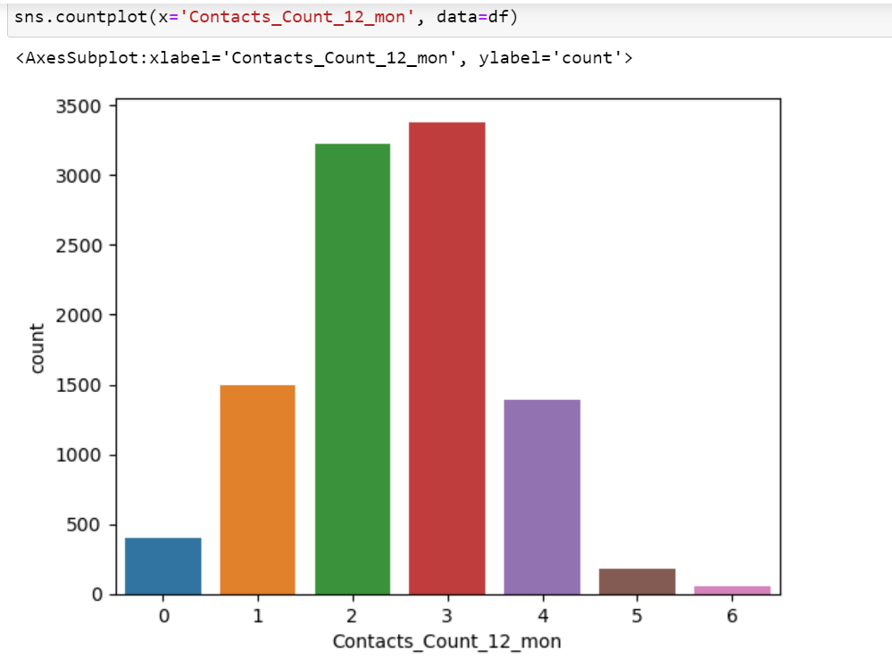
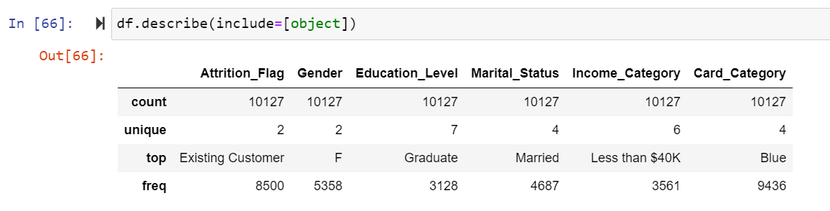

Understanding Customer Data

Slide 5

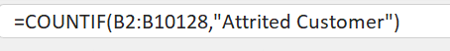
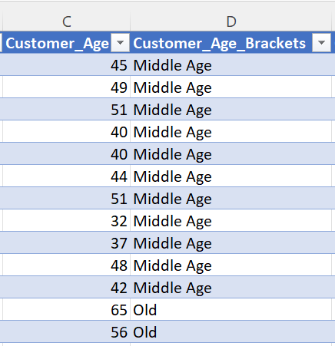
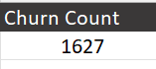
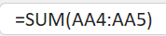
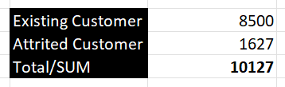
Data Pre-Processing & Manipulation
I used Excel in order to understand how many customers have churned (using the COUNT IF function) and also to see the differences in the amount between Existing and Attrited Customers. I then used SUM to calculate the total amount of customers. I also used the IF statement to group the age into brackets so it simplifies my further analysis and visualisation.
Using COUNT IF
Using IF Function
Using COUNT IF and SUM

Slide 6

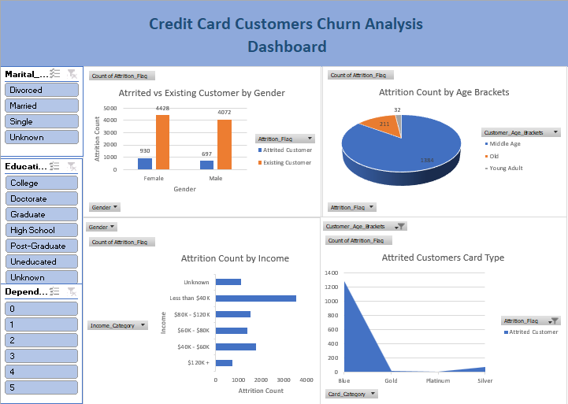
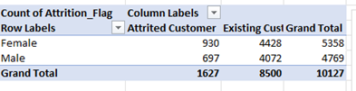
Analysis using Microsoft Excel
I then did a Pivot Table and created a mini dashboard from my Pivot Graphs in order to easily see the attrition across the different demographics.
________________________________________________
I then used slicers to drilldown, comparing the variables with marital status, educational level and dependent count.
________________________________________________

Slide 7

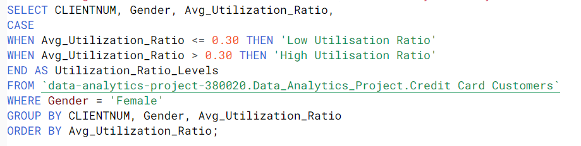
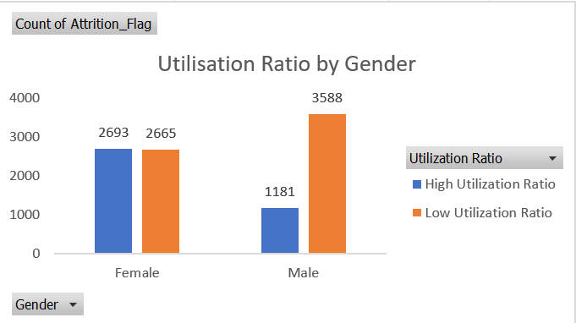
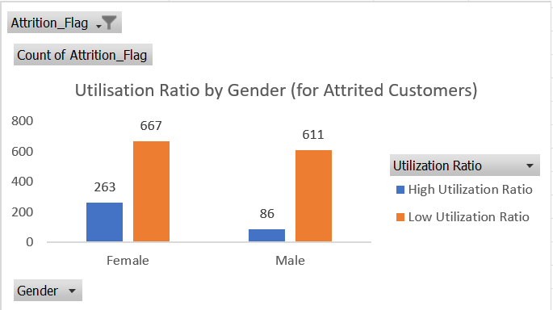
SQL Analysis
Understanding customers’ behaviour based on Customer Utilization Ratio

Slide 8
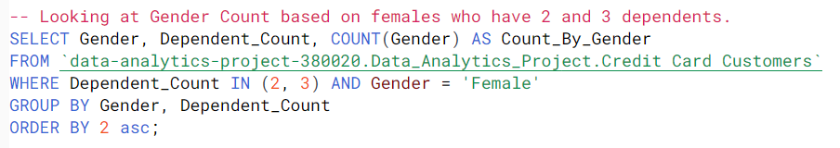
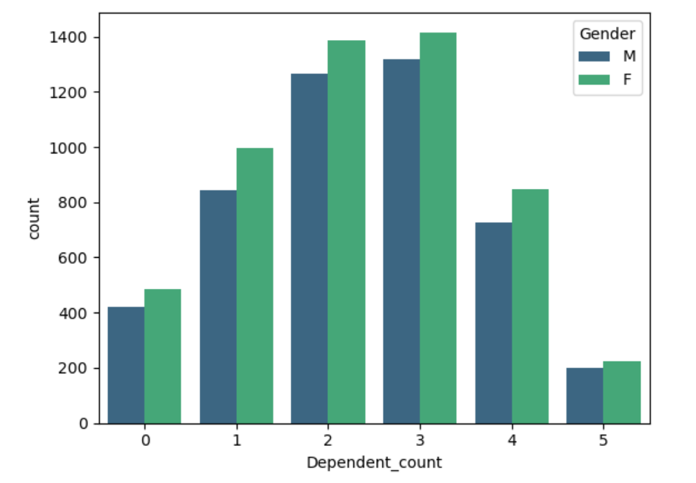
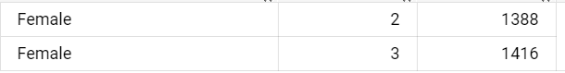
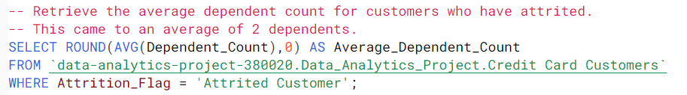
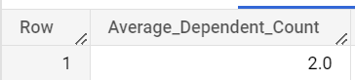
Understanding Customers’ Dependent Count

Slide 9
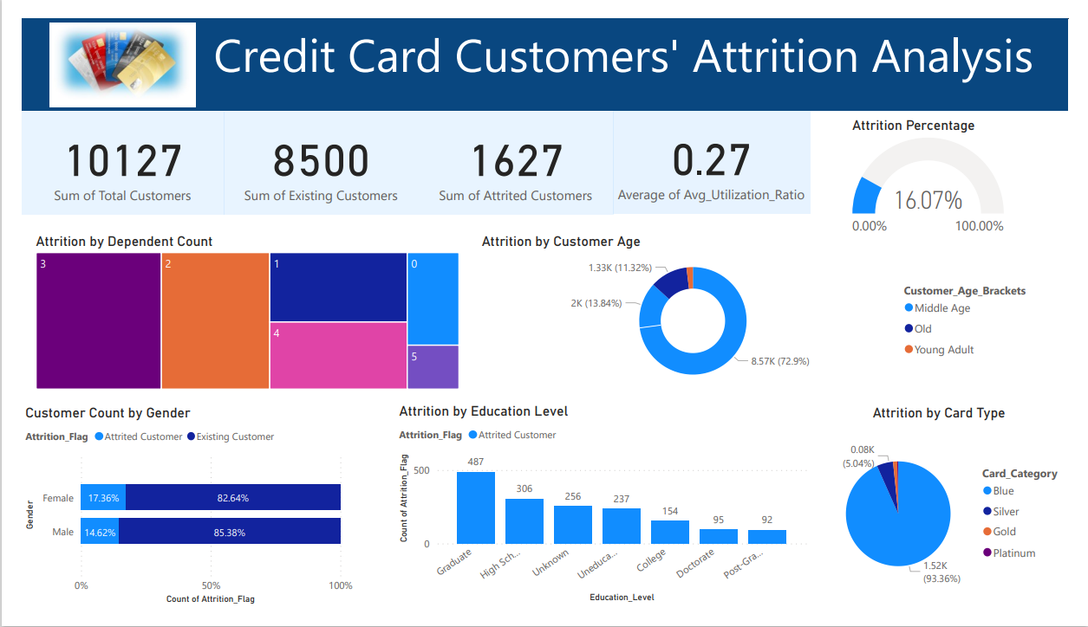
Dashboard using Microsoft Power BI

Slide 10





Recommendations/Insights
1. Focus on the areas where the bank is losing customers based on demographics (We identified that churn is typically coming from Females, Middle Aged, Married/Single, Blue Card holders with a dependent count of 2/3 dependents).
2. They could offer incentives by introducing rewards/special offers to those customers and also monitor their competitor’s offerings. It is possible that customers are churning to competitors. The Bank Manager can use the information gained from the utilisation ratio and other variables (e.g. card type) for females, to strategize on best approach.
3. Be more proactive with communication. Increase frequency of customer contacts to perhaps keep customers up to date with services and incentives, to ask for feedback, and to identify any issues as early as possible.

Slide 11

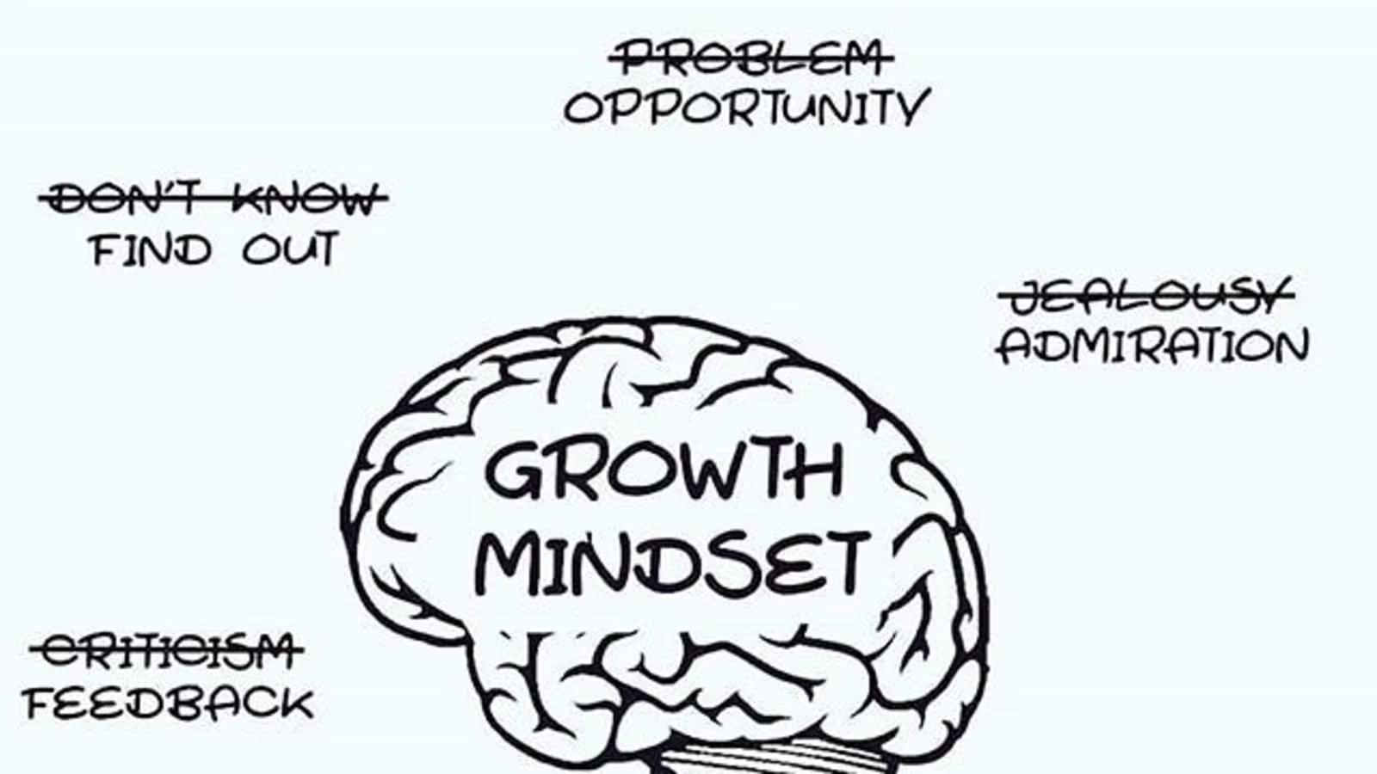



Conclusion and Key Learnings
EDUCATIONALLY - Upskilling and learning technical skills. I learned how to code for the first time using SQL and Python. - Skilled in Advanced Excel, SQL, Python, Power BI and Tableau - I have a number of projects on my GitHub to showcase these skills. MariaTayo (Maria Tayo) · GitHub PERSONALLY - I was able to learn more about myself and to really see my potential. - I’ve been able to become more self aware which has helped me to become more confident. CAREER WISE - I learned that my law career was a building block, and that me coming into Tech was not me starting again but me just taking another step forward on my career journey.

